Slide 1
DPO-SYNT Usage Guide
A Short Example
Nicholas Recker

Slide 2
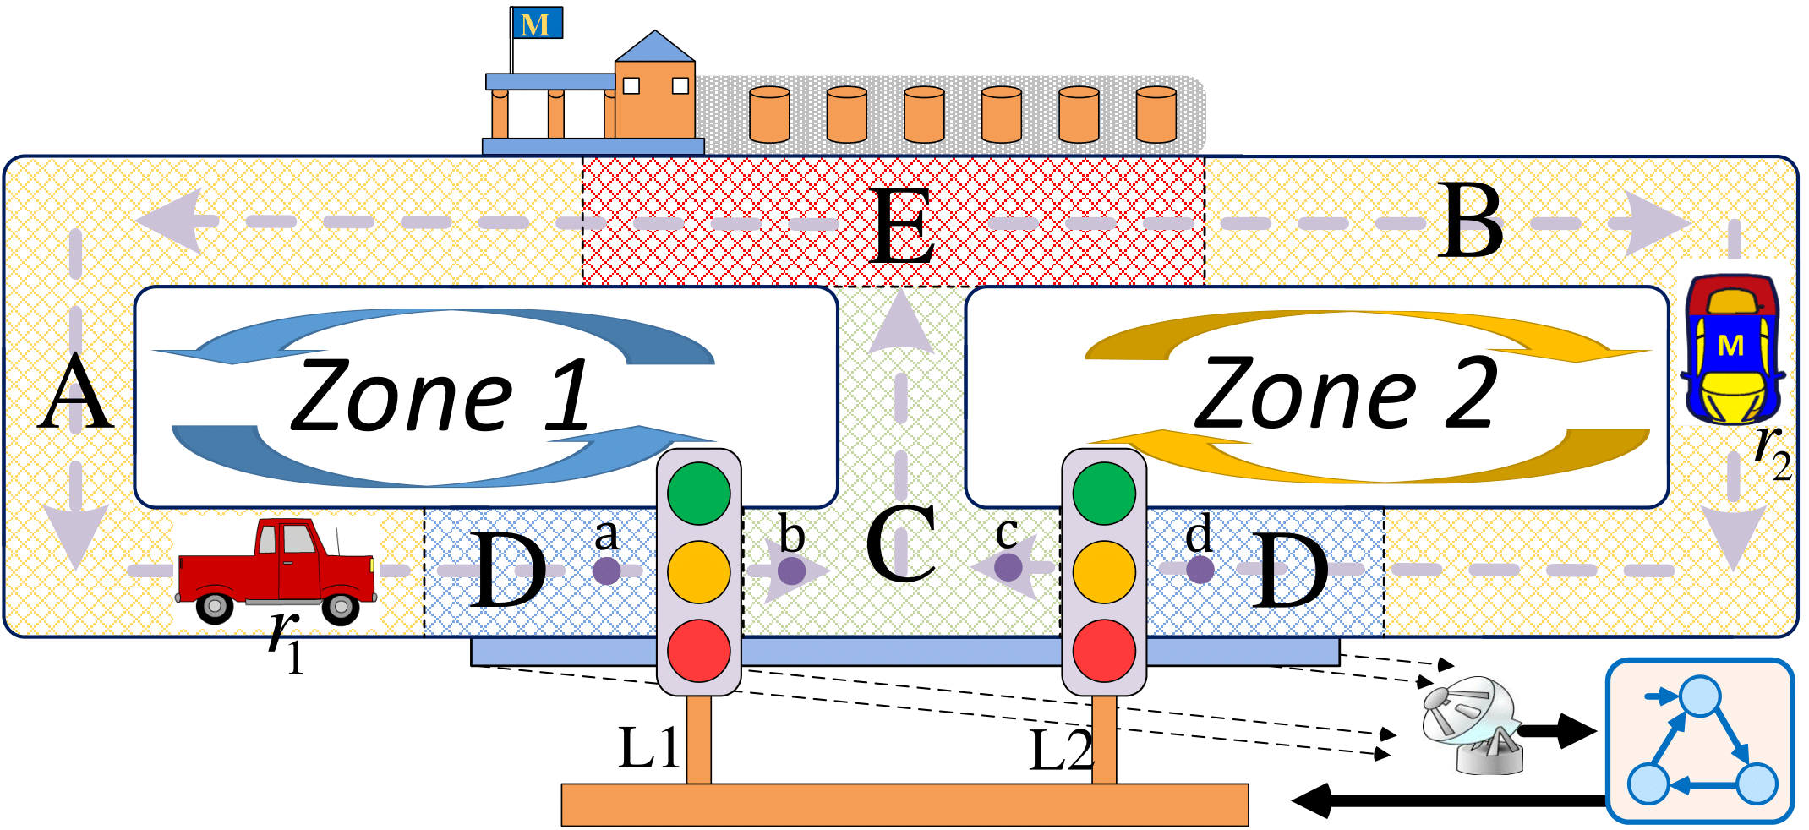
Example: Street Cleaning Robots
System Model
One way streets
Only one robot, r₁ or r₂, each day
Control
Two traffic lights, L₁ and L₂
When L₁ is red
r₁ at a must wait
r₂ at c may wait or turn right
L₂ is analogous
Notes:
System Model: Consider the following guide way problem:
A town is divided into two zones, zone 1 and zone 2, with single-way streets as shown in Fig. 6. At the top of the zones, there is a recycling station. Everyday, only one zone will send a robot (r1 or r2) to clean up the streets. The robot sent by zone 1 can only move counter-clockwise, i.e., move forward or turn left; the robot sent by zone 2 can only move clockwise.
Control: There are two traffic lights, L1 and L2, close to the bottom intersection as shown in the figure. The lights control the robots as follows:
When L1 is red, if robot r1 is at point a, then it must wait until the light turns green;
if robot r2 is at point c, then it can choose to wait there or turn right. The effect of L2 is analogous.

Slide 3
Sensing
Radar detects whether robot in D
Cannot distinguish between zones
Specification
Obey one way streets
Always eventually reach E
Events
a_{i}: r_{i} is chosen for the day 不可控不可观
b_{i}: r_{i} empties trash at E不可控不可观
c_{i}: Robot crosses L_{i} either direction可控不可观
O: Robot detected in D 可观不可控
Notes:
Sensing: There is a radar around the traffic lights that detects whether there is a robot in region D, which is in front of each light, every time unit. However, the radar cannot distinguish which zone the detected robot belongs to.
Specification: Since all streets are one-way streets, with legal directions shown in Fig. 6, we do not want movement in the reverse direction to happen. Without any traffic light, the robot from zone 1 could possibly violate this specification by entering zone 2 through the points a, b, c and d. Clearly, if both L1 and L2 are kept red, then the above specification can be satisfied trivially. However, in order for the robot to be able to unload the trash it collected along the streets, we require that the robot should always be able to enter region E. In summary, the goal for us is to design a control policy for the traffic lights for one day’s operation based on the radar information and such that the above requirements are satisfied.
The above problem can be modeled as a supervisory control problem under partial observation. First, we use unobservable and uncontrollable events a1 and a2 to represent the nondeterministic initial setting, since we do not know where the robot starts from. Event o is used to model the event that the radar detects a robot in region D, which is observable but not controllable. We use event c1 to represent that there is a robot that crosses L1 (from the RHS(Right-Hand-Side) to the LHS(Left-Hand Side) or from the LHS to the RHS); this event is controllable but not observable. We define c2 analogously for the control effect of L2. Events b1 and b2 represent that robots r1 and r2 unload their trash,respectively; these events are unobservable and uncontrollable. The automaton model G of this system is shown in Fig. 7(a), in which states 9 and 10 are illegal states.

Slide 4
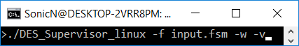
Command Line input
-f Provide an FSM input file
-w Write output to .fsm files in ./results
-v Write output to terminal

Slide 5
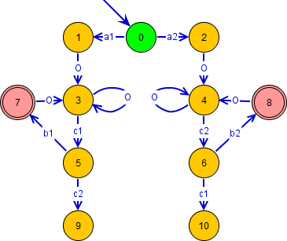
Input File: .fsm
.fsm file of original system
Desuma format
E.g.
11
0 0 2
a1 1 uc uo
a2 2 uc uo
...
For G: Ec = {c1, c2}可控不可观,
Eo = {o}可观不可控, and states 9 and 10 are illega,
ai,bi不可控不可观

Slide 6
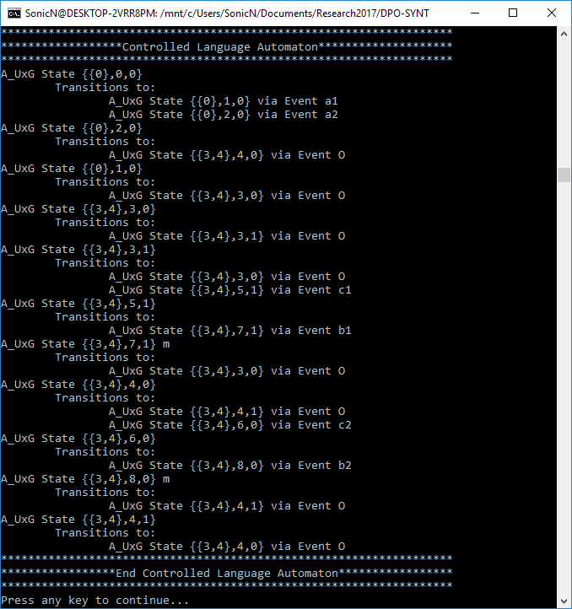
Command Line Output
Non-Blocking All Inclusive Controller
Unfolded Bipartite Transition System
Inter-Connected System
Live Decision String
Controlled Language Automaton (Shown)

Slide 7
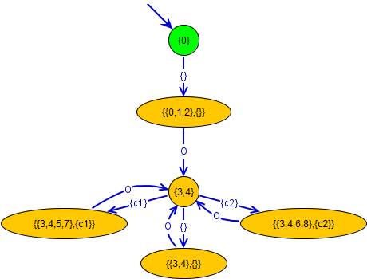
Output File: NBAIC.fsm
.fsm file of Non-Blocking All Inclusive Controller
Desuma Format
E.g.
6
{0} 0 1
{} {{0,1,2},{}} c o
...
<event name> <next state name> <controlable ? c(Y) : uc(N)> <observable? o(Y) : uo(N)>

Slide 8
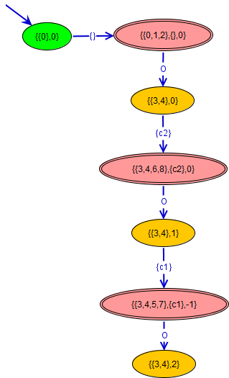
Output File: UBTS.fsm
.fsm file of final iteration of Unfolded Bipartite Transition System
Desuma format
E.g.
7
{{0},0} 0 1
{} {{0,1,2},{},0} c o
...

Slide 9
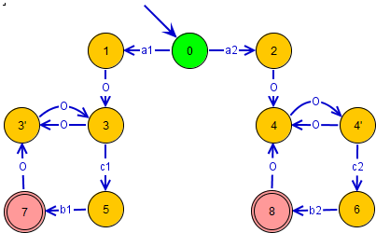
Output File: A_UxG_reduced.fsm
.fsm file of closed loop behavior
Desuma format
E.g.
11
0 0 2
a2 2 uc uo
a1 1 uc uo
...

Slide 10
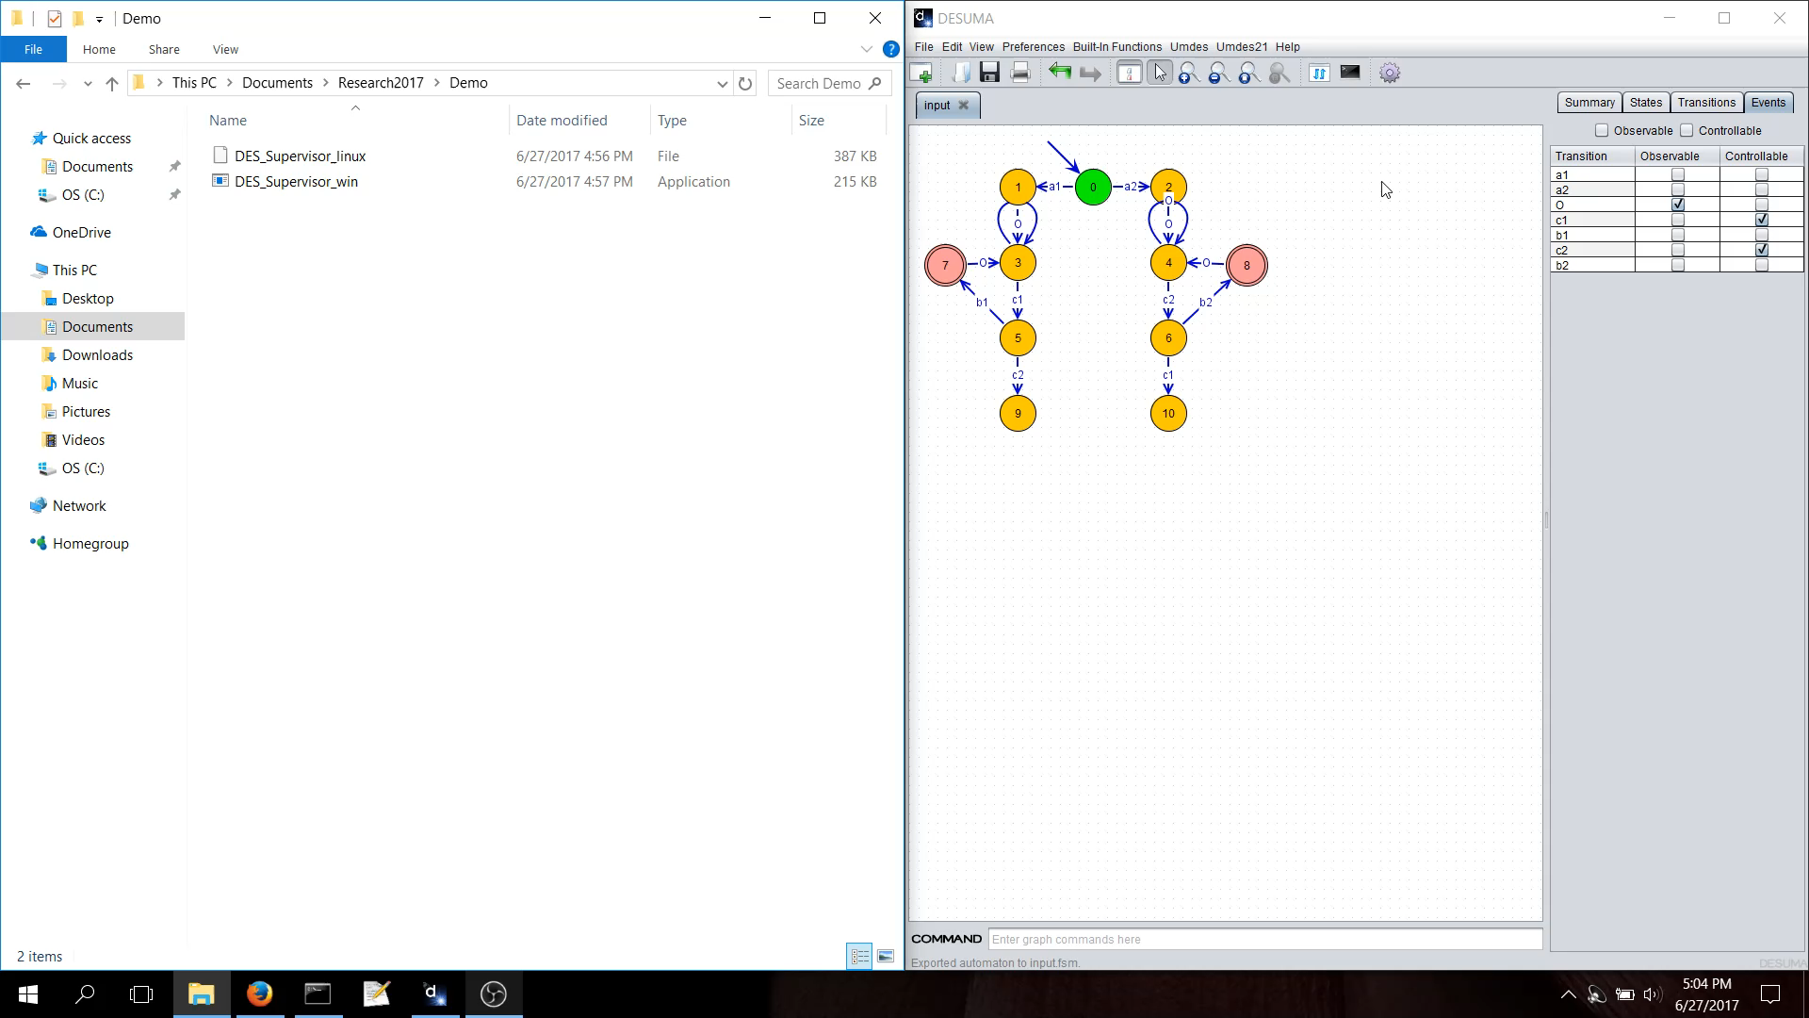
Video Demonstration

